Slide 1


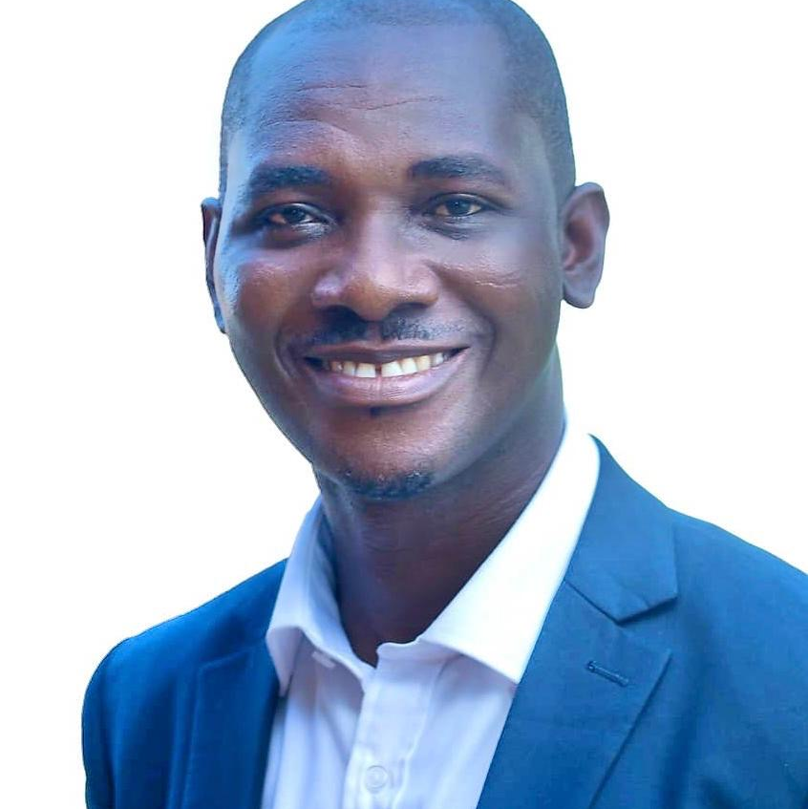
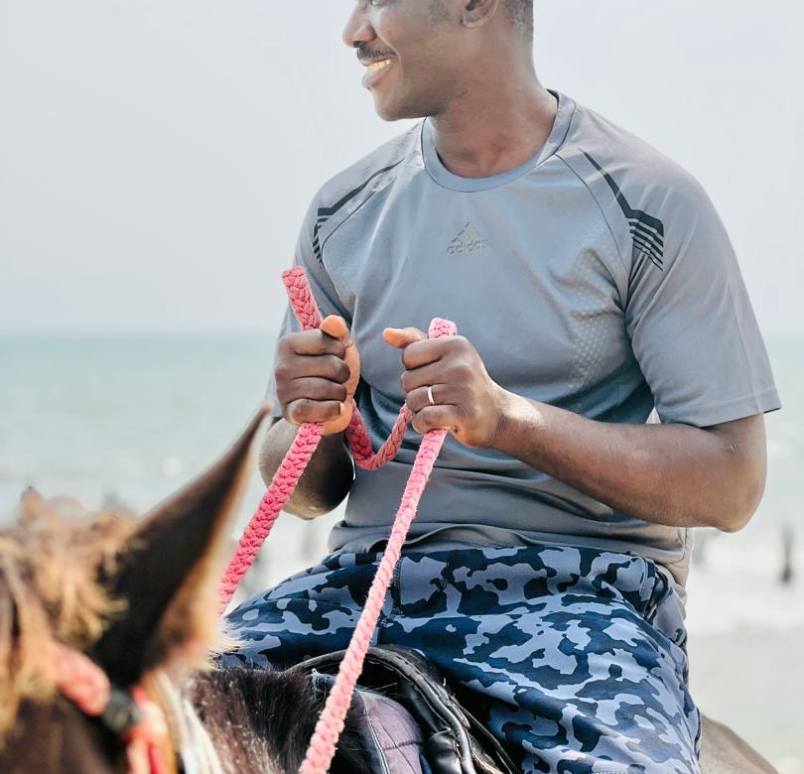
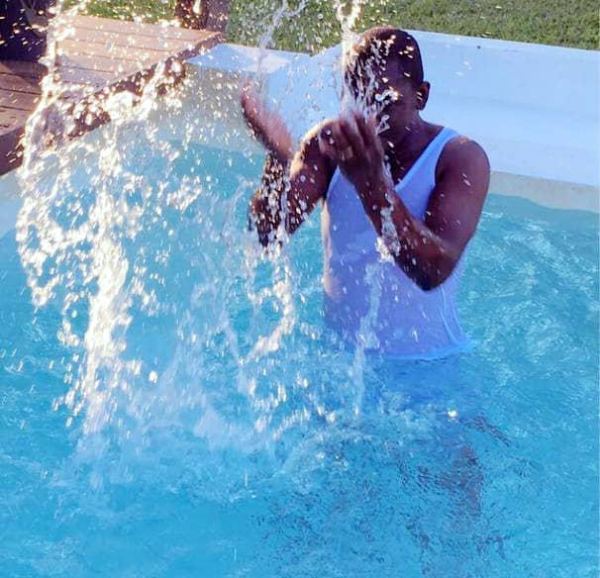
Getting to Know Me
Work
Personal
My role
Brach Coordinator
Significant others / family members / furry friends in my life
Sandra, Asantewa and Cats
Tenure in ofi/Olam
11 years
How I enjoy spending my free time
Watching Movies and Football
Previous companies I have worked at
Mamas Business Services and Ghana Education Service
My favorite / comfort food
Fufu&Palm Nut Soup
Why I joined ofi/Olam and what keeps me here?
There is always a new challenge. ofi gives opportunity for growth
My favorite song
What an awesome God by Phil Wickham
Nicholas Chris Baah
‘Chris’
I’ve never broken a bone, but I’ve broken three phones
This is me outside work, doing stuff I enjoy in my life …

